Slide 1

Analysis of BA travellers’ Reviews From Skytrax
Presented by
Chidiogo Maureen Maduka

Slide 2
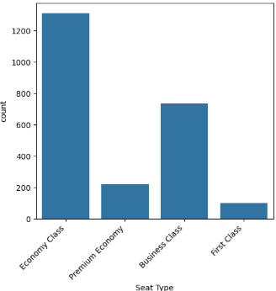
Data collection
Data was scraped from Skytrax website and cleaned using the python library-BeautifulSoup that eliminates html tags and elements.
With 2367 not null rows of reviews, Economy Class with 1310 goes to show that at least half of the reviews were from Economy class travellers

Slide 3
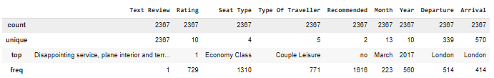
Data Exploration
One third of these reviewers travelled based on couple leisure. An astonishing number of 1616 choose not to recommend BA for reasons that required further digging in order to explain this outrageous number.
It is also important to notice that as at the time of this report, the most travelled month is March and 2017 appears to be the most travelled year.

Slide 4
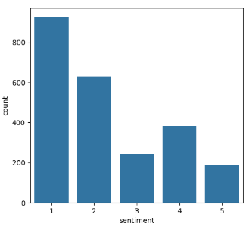
Sentiment Analysis
Using the pretrained huggingface model to derive the perception of customers towards a product or service and comparing its results to the ratings given by customers as well as their willingness to recommend or not to, gives a brief insight into customers' level of satisfaction. This model generates 5 categories, very negative, negative, neutral, positive, to very positive.

Slide 5
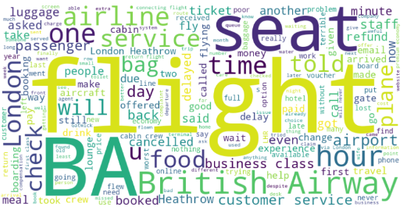
Negative sentiment polarity
This is a collection of recurring or frequently used words from the review of those that the model identifies as very negative

Slide 6
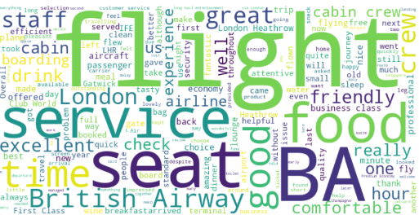
Positive sentiment polarity
This is a collection of recurring or frequently used words from the review of those that the model identifies as very positive

Slide 7
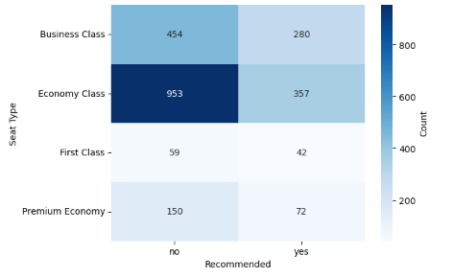
Distribution of recommendation across classes
The interesting discovery at this point is the variance in opinion of service as the classes upgrade. The economy class show more dissatisfaction than all the other users such that nearly two third or 70% chose not to recommend

Slide 8
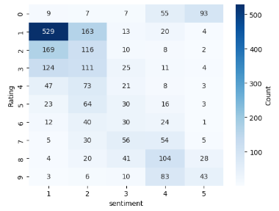

Distribution of recommendation across classes
The level of satisfaction of services is obtained and expressed from the Rating column. This is very consistent with the recommendation column and logic that a satisfied client expressed in the high rating would most likely recommend and so also is found conversely.

Slide 9
Conclusion
Using the BERT pretrained huggingface model to derive the perception of customers towards a product or service and comparing its results to the ratings given by customers as well as their willingness to recommend or not to, gives a brief insight into customers' level of satisfaction. This model generates 5 categories, very negative, negative, neutral, positive, to very positive.
Based on the sentiment analysis, backed up by the pattern seen in the rating and recommendation variables while considering the different customer class, it is apparent that a significant number expressed their dissatifaction and displeasure towards the services by the low to average ratings and lack of will power to recommend.
Noting that the large chunk stems from the Economy class. Although First class appear to have a nearly normal distribution, with regards to its sentiment distribution and recommendation, it still potrays, that services could be improved on not just in this class but across all classes.

